Slide 1
SEQUENTIAL CIRCUIT
GATED LATCH

Slide 2
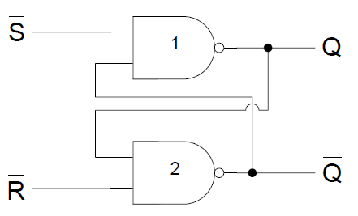
SR L ATCH

Slide 3
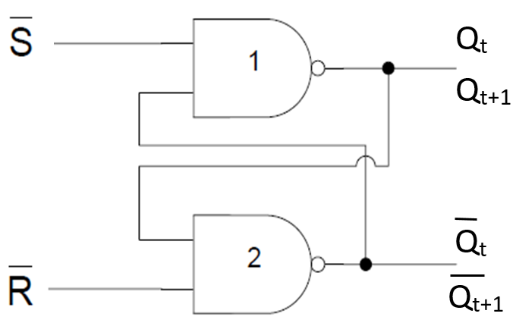
SR L ATCH

Slide 4
SR LATCH TABLE
0 | 0 | INVALID CONDITION
0 | 1 | 1 | 0
1 | 0 | 0 | 1
1 | 1

Slide 5
SR LATCH TABLE
 |  |  |  | COMMENT
0 | 0 | 1 | 1 | INVALID CONDITION
0 | 1 | 1 | 0 | SET
1 | 0 | 0 | 1 | RESET
1 | 1 |  |  | NO CHANGE

Slide 6
SR LATCH TABLE
0 | 0 | invalid
0 | 1 | 1
1 | 0 | 0
1 | 1

Slide 7
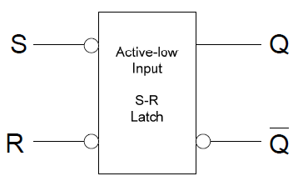
LOGIC SYMBOL

Slide 8
GATED SR LATCH
Gated SR latch requires an enable input.

Slide 9
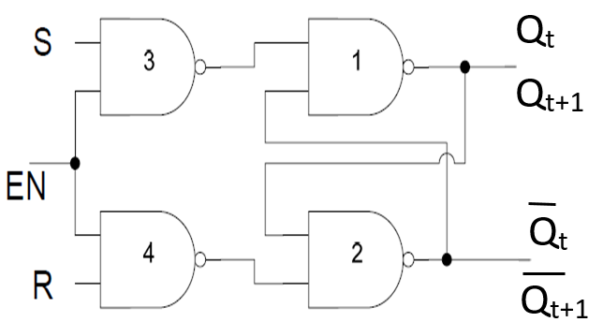
GATED SR LATCH

Slide 10
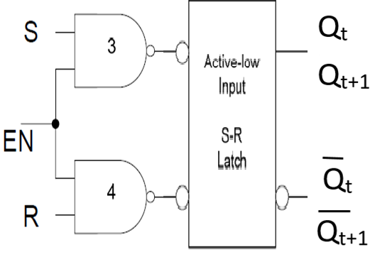
GATED SR LATCH

Slide 11
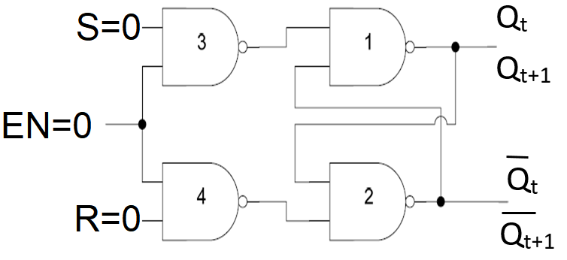
GATED SR LATCH
EN | S | R
0 | 0 | 0

Slide 12

GATED SR LATCH
EN | S | R
0 | X | X

Slide 13
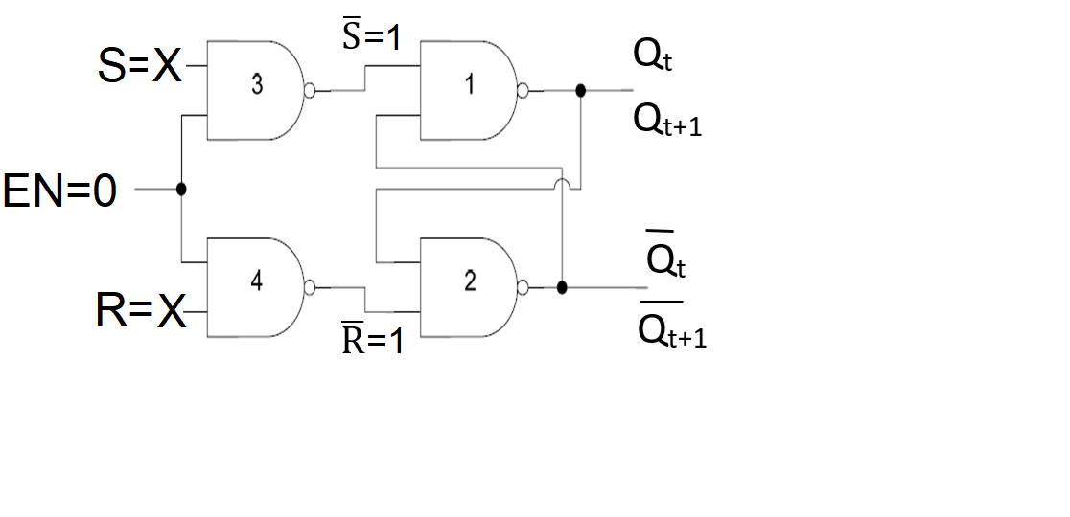
GATED SR LATCH
EN | S | R
0 | X | X | 1 | 1
0 | 0 | INVALID
0 | 1 | 1
1 | 0 | 0
1 | 1

Slide 14
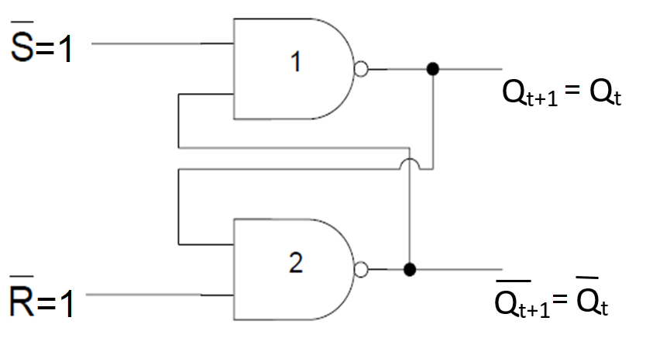
GATED SR LATCH
EN | S | R
0 | X | X | 1 | 1
0 | 0 | INVALID
0 | 1 | 1
1 | 0 | 0
1 | 1

Slide 15
GATED SR LATCH TABLE
EN | S
0 | X | X
1 | 0 | 0
1 | 0 | 1
1 | 1 | 0
1 | 1 | 1

Slide 16
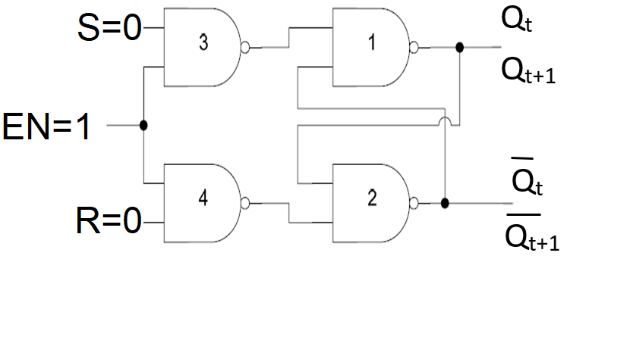
GATED SR LATCH
EN | S | R
1 | 0 | 0

Slide 17
GATED SR LATCH
EN | S | R
1 | 0 | 0 | 1 | 1

Slide 18
GATED SR LATCH
EN | S | R
1 | 0 | 0 | 1 | 1
0 | 0 | INVALID
0 | 1 | 1
1 | 0 | 0
1 | 1

Slide 19
GATED SR LATCH
EN | S | R
1 | 0 | 0 | 1 | 1
0 | 0 | INVALID
0 | 1 | 1
1 | 0 | 0
1 | 1

Slide 20
GATED SR LATCH TABLE
EN | S
0 | X | X
1 | 0 | 0
1 | 0 | 1
1 | 1 | 0
1 | 1 | 1

Slide 21
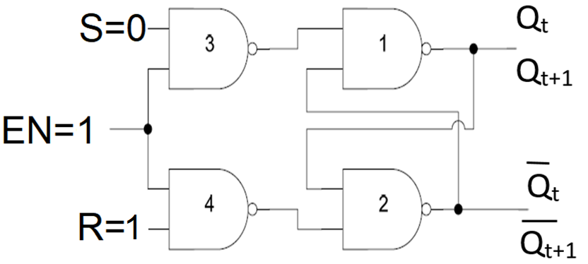
GATED SR LATCH
EN | S | R
1 | 0 | 1

Slide 22
GATED SR LATCH
EN | S | R
1 | 0 | 1 | 1 | 0

Slide 23
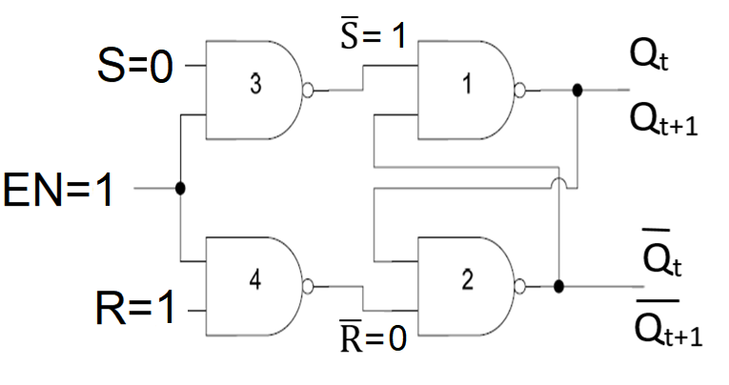
GATED SR LATCH
EN | S | R
1 | 0 | 1 | 1 | 0
0 | 0 | INVALID
0 | 1 | 1
1 | 0 | 0
1 | 1

Slide 24
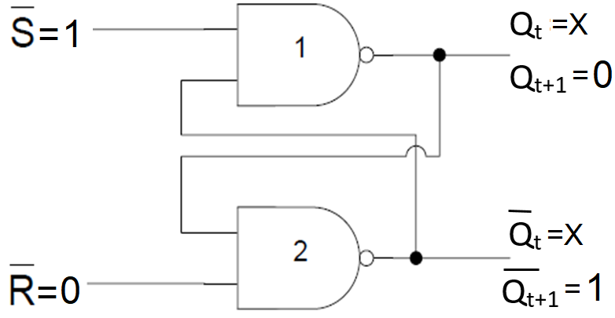
GATED SR LATCH
EN | S | R
1 | 0 | 1 | 1 | 0 | 0 | 1
0 | 0 | INVALID
0 | 1 | 1
1 | 0 | 0
1 | 1

Slide 25
GATED SR LATCH TABLE
EN | S
0 | X | X
1 | 0 | 0
1 | 0 | 1 | 0 | 1
1 | 1 | 0
1 | 1 | 1

Slide 26
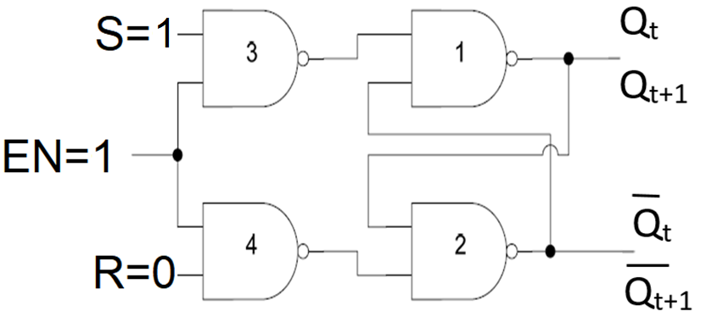
GATED SR LATCH
EN | S | R
1 | 1 | 0

Slide 27
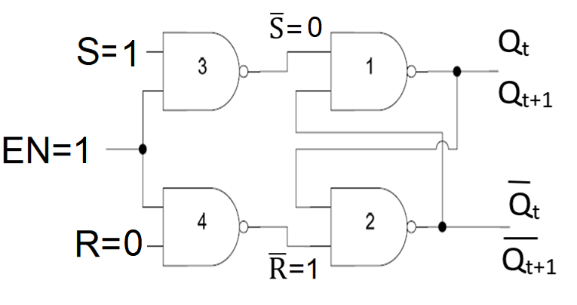
GATED SR LATCH
EN | S | R
1 | 1 | 0 | 0 | 1
0 | 0 | INVALID
0 | 1 | 1
1 | 0 | 0
1 | 1

Slide 28
GATED SR LATCH
EN | S | R
1 | 1 | 0 | 0 | 1
0 | 0 | INVALID
0 | 1 | 1
1 | 0 | 0
1 | 1

Slide 29
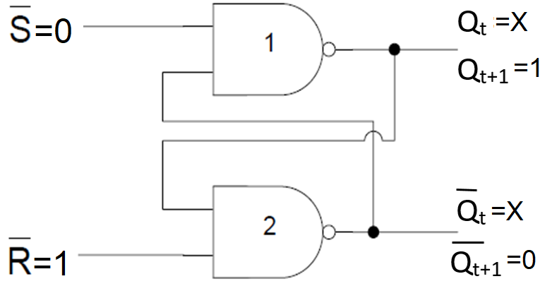
GATED SR LATCH
EN | S | R
1 | 1 | 0 | 0 | 1 | 1 | 0
0 | 0 | INVALID
0 | 1 | 1
1 | 0 | 0
1 | 1

Slide 30
GATED SR LATCH TABLE
EN | S
0 | X | X
1 | 0 | 0
1 | 0 | 1 | 0 | 1
1 | 1 | 0 | 1 | 0
1 | 1 | 1

Slide 31
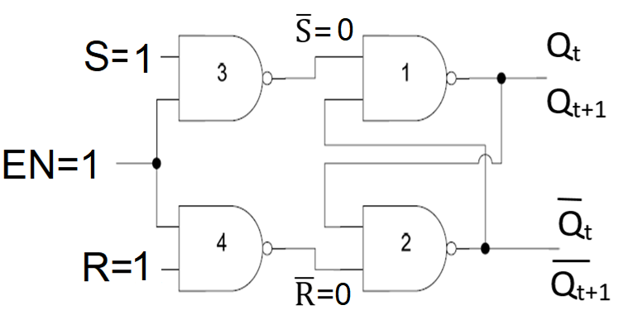
GATED SR LATCH
EN | S | R
1 | 1 | 1

Slide 32

GATED SR LATCH
EN | S | R
1 | 1 | 1 | 0 | 0
0 | 0 | INVALID
0 | 1 | 1
1 | 0 | 0
1 | 1

Slide 33
GATED SR LATCH
EN | S | R
1 | 1 | 1 | 0 | 0
0 | 0 | INVALID
0 | 1 | 1
1 | 0 | 0
1 | 1

Slide 34
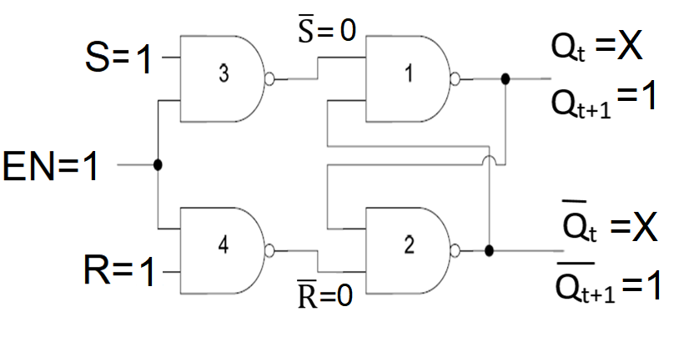
GATED SR LATCH
EN | S | R
1 | 1 | 1 | 0 | 1 | 1 | 1
0 | 0 | INVALID
0 | 1 | 1
1 | 0 | 0
1 | 1

Slide 35
GATED SR LATCH TABLE
EN | S
0 | X | X
1 | 0 | 0
1 | 0 | 1 | 0 | 1
1 | 1 | 0 | 1 | 0
1 | 1 | 1 | 1 | 1

Slide 36
GATED SR LATCH TABLE
EN | S
0 | X | X
1 | 0 | 0
1 | 0 | 1 | 0 | 1
1 | 1 | 0 | 1 | 0
1 | 1 | 1 | INVALID

Slide 37
GATED SR LATCH TABLE SUMMARY
EN | S
0 | X | X
1 | 0 | 0
1 | 0 | 1 | 0
1 | 1 | 0 | 1
1 | 1 | 1 | INVALID

Slide 38
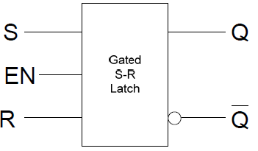
BLOCK DIAGRAM

Slide 39
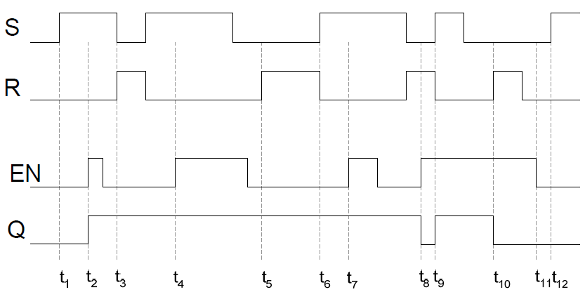
TIMING DIAGRAMS
EN | S
0 | X | X
1 | 0 | 0
1 | 0 | 1 | 0
1 | 1 | 0 | 1
1 | 1 | 1 | INVALID

Slide 40
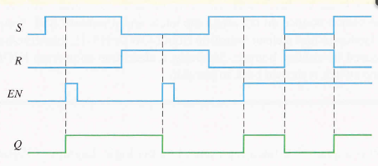
TIMING DIAGRAMS
EN | S
0 | X | X
1 | 0 | 0
1 | 0 | 1 | 0
1 | 1 | 0 | 1
1 | 1 | 1 | INVALID

Slide 41
GATED D LATCH
Gated D latch is called Transparent Latch.

Slide 42
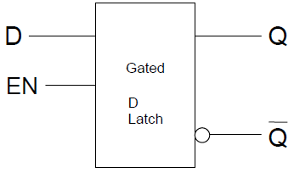
GATED D LATCH

Slide 43
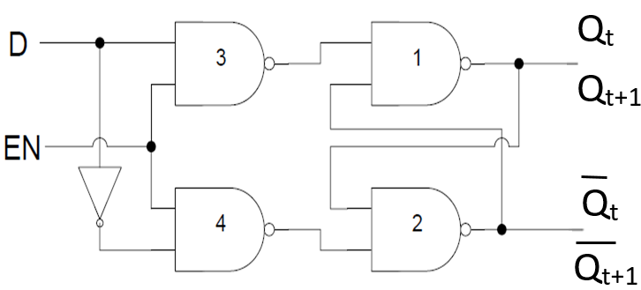
GATED D LATCH

Slide 44
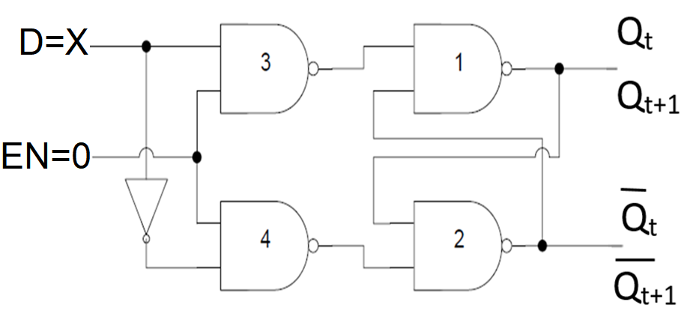
GATED D LATCH
EN | D | S | R
0 | X | X | X

Slide 45
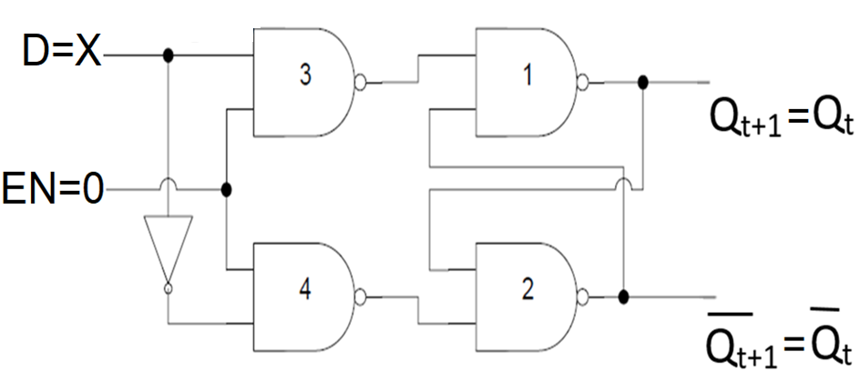
GATED D LATCH
EN | D | S | R
0 | X | 0 | 0
EN | S
0 | X | X
1 | 0 | 0
1 | 0 | 1 | 0
1 | 1 | 0 | 1
1 | 1 | 1 | INVALID

Slide 46
GATED D LATCH TABLE
EN | D
0 | X
1 | 0
1 | 1

Slide 47
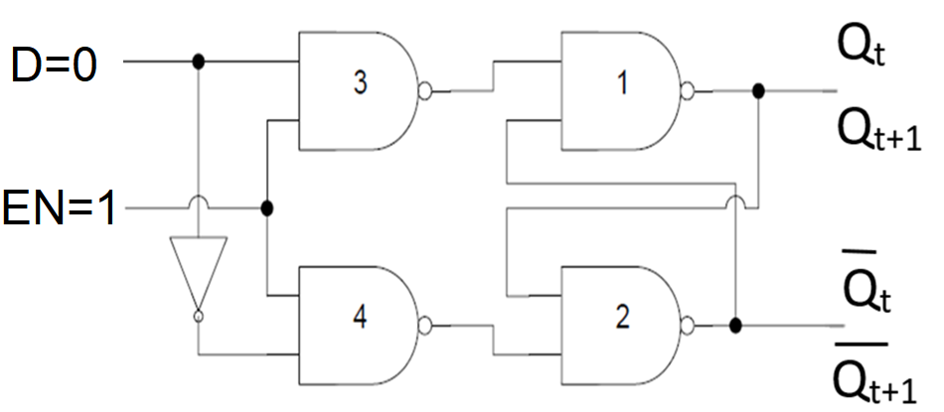
GATED D LATCH
EN | D | S | R
1 | 0

Slide 48
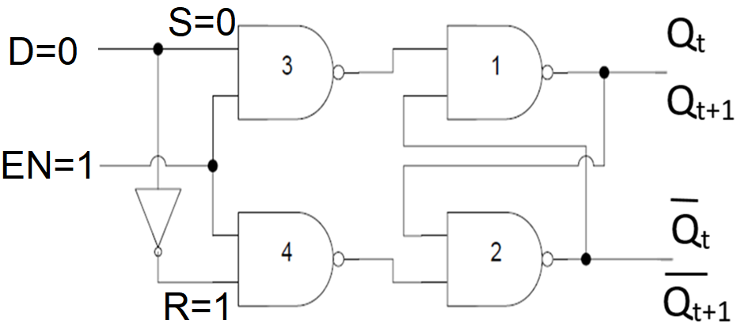
GATED D LATCH
EN | D | S | R
1 | 0 | 0 | 1

Slide 49
GATED D LATCH
EN | D | S | R
0 | X | 0 | 0
EN | S
0 | X | X
1 | 0 | 0
1 | 0 | 1 | 0
1 | 1 | 0 | 1
1 | 1 | 1 | INVALID

Slide 50
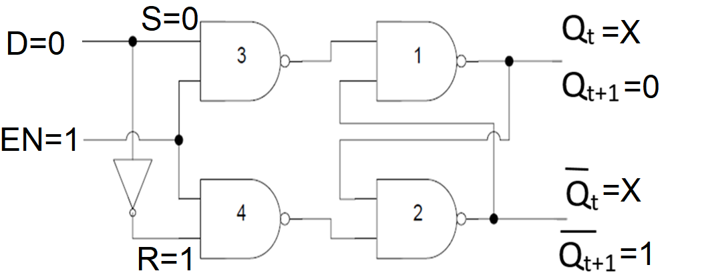
GATED D LATCH
EN | D | S | R
1 | 0 | 0 | 1 | 0 | 1
EN | S
0 | X | X
1 | 0 | 0
1 | 0 | 1 | 0
1 | 1 | 0 | 1
1 | 1 | 1 | INVALID

Slide 51
GATED D LATCH TABLE
EN | D
0 | X
1 | 0 | 0 | 1
1 | 1

Slide 52
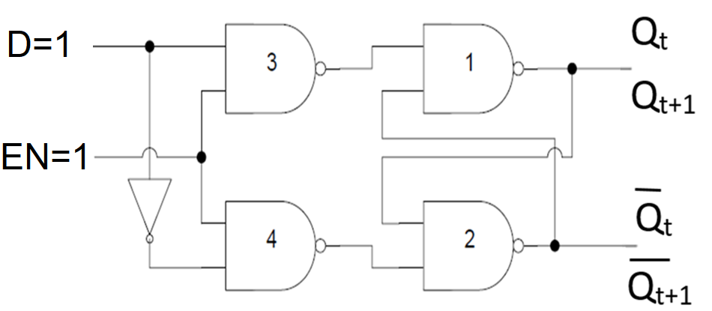
GATED D LATCH
EN | D | S | R
1 | 1

Slide 53
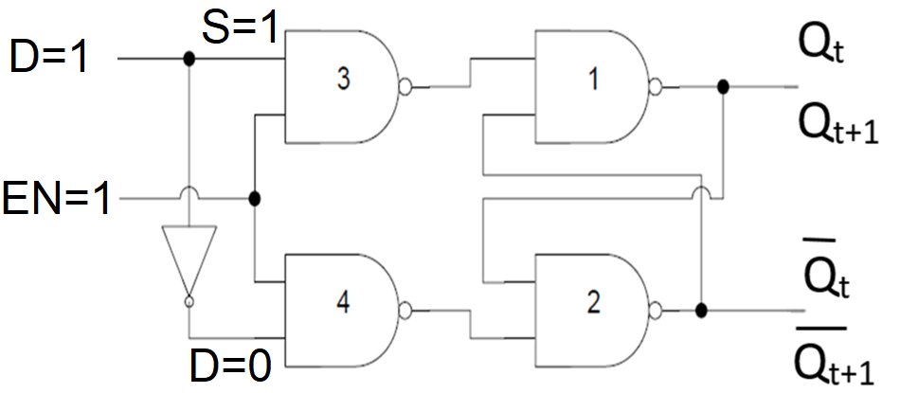
GATED D LATCH
EN | D | S | R
1 | 1 | 1 | 0

Slide 54
GATED D LATCH
EN | D | S | R
0 | X | 0 | 0
EN | S
0 | X | X
1 | 0 | 0
1 | 0 | 1 | 0
1 | 1 | 0 | 1
1 | 1 | 1 | INVALID

Slide 55
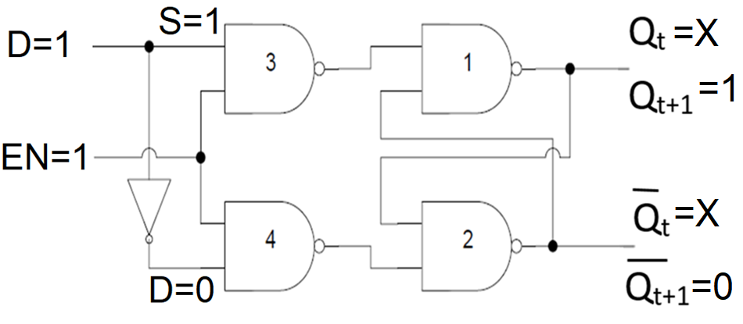
GATED D LATCH
EN | D | S | R
1 | 1 | 1 | 0 | 1 | 0
EN | S
0 | X | X
1 | 0 | 0
1 | 0 | 1 | 0
1 | 1 | 0 | 1
1 | 1 | 1 | INVALID

Slide 56
GATED D LATCH TABLE
EN | D
0 | X
1 | 0 | 0 | 1
1 | 1 | 1 | 0

Slide 57
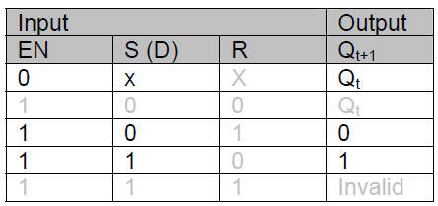
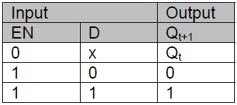
GATED D LATCH TABLE

Slide 58
GATED D LATCH TABLE SUMMARY
EN | D
0 | X
1 | 0 | 0
1 | 1 | 1

Slide 59
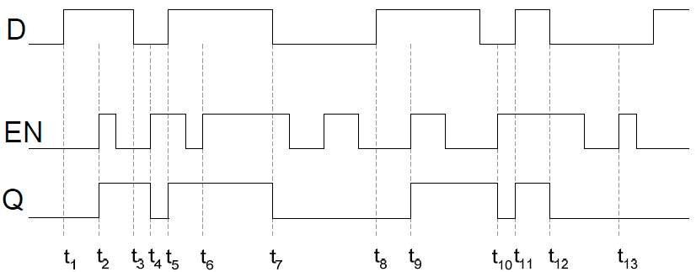
TIMING DIAGRAM D LATCH
EN | D
0 | X
1 | 0 | 0
1 | 1 | 1

